Slide 1
Draw Backs of JDBC :
In JDBC, if we open a database connection we need to write in try, and if any exceptions occurred catch block will takers about it, and finally used to close the connections.
Hear as a programmer we must close the connection, or we may get a chance to get our of connections message…!
Actually if we didn’t close the connection in the finally block, then jdbc doesn’t responsible to close that connection.
In JDBC we need to write Sql commands in various places, after the program has created if the table structure is modified then the JDBC program doesn’t work, again we need to modify and compile and re-deploy required, which is tedious.
JDBC used to generate database related error codes if an exception will occurs, but java programmers are unknown about this error codes right.
In the Enterprise applications, the data flow with in an application from class to class will be in the form of objects, but while storing data finally in a database using JDBC then that object will be converted into text. Because JDBC doesn’t transfer objects directly.

Slide 2
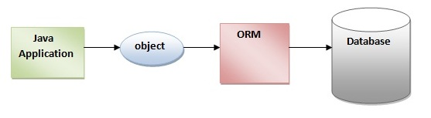
Hibernate Hibernate is an object-relational mapping tool (ORM) that allows for persisting Java objects in a relational database. Officially maintained by Jboss, Inc, started in December, 2001 Opensource (LGPL) Current Version is 3.2 Will be core of JBoss CMP 2.0 engine

Slide 3
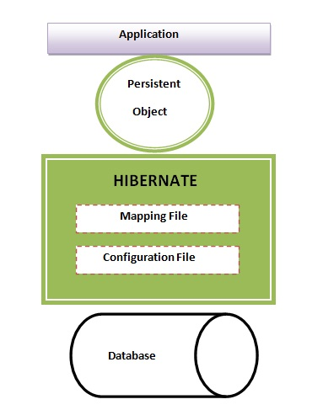
Architecture
Hibernate basically sits between the DB and application
Can map persistent objects to tables

Slide 4
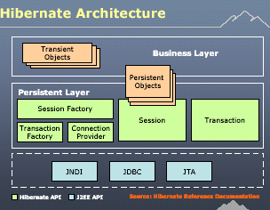
Architecture

Slide 5
Hibernate
Hibernate is the ORM tool given to transfer the data between a java (object) application and a database (Relational) in the form of the objects.
Hibernate is the open source light weight tool given by Gavin King, actually JBoss server is also created by this person only.
Hibernate is a non-invasive framework, means it wont forces the programmers to extend/implement any class/interface, and in hibernate we have all POJO classes so its light weight.
Hibernate can runs with in or with out server, i mean it will suitable for all types of java applications (stand alone or desktop or any servlets bla bla.)
Hibernate is purely for persistence (to store/retrieve data from Database).

Slide 6
Advantages of hibernates:
Hibernate supports Inheritance, Associations, Collections
In hibernate if we save the derived class object, then its base class object will also be stored into the database, it means hibernate supporting inheritance
Hibernate supports relationships like One-To-Many,One-To-One, Many-To-Many-to-Many, Many-To-One
This will also supports collections like List,Set,Map (Only new collections)
In jdbc all exceptions are checked exceptions, so we must write code in try, catch and throws, but in hibernate we only have Un-checked exceptions, so no need to write try, catch, or no need to write throws. Actually in hibernate we have the translator which converts checked to Un-checked
Hibernate has capability to generate primary keys automatically while we are storing the records into database
Hibernate has its own query language, i.e hibernate query language which is database independent
So if we change the database, then also our application will works as HQL is database independent
HQL contains database independent commands
While we are inserting any record, if we don’t have any particular table in the database, JDBC will rises an error like “View not exist”, and throws exception, but in case of hibernate, if it not found any table in the database this will create the table for us
Hibernate supports caching mechanism by this, the number of round trips between an application and the database will be reduced, by using this caching technique an application performance will be increased automatically.
Hibernate supports annotations, apart from XML
Hibernate provided Dialect classes, so we no need to write sql queries in hibernate, instead we use the methods provided by that API.
Getting pagination in hibernate is quite simple.

Slide 7
Disadvantages of hibernates:
I don’t think there are disadvantages in hibernate
You know some thing.., Its saying hibernate is little slower than pure JDBC, actually the reason being hibernate used to generate many SQL statements in run time.

Slide 8
TestUser - Add
public static void testAdd() throws Exception {
UserDTO dto = new UserDTO();
dto.setFirstName(“Ajay");
dto.setLastName(“Jirati"); //Prepare DTO
...
SessionFactory sessionFactory = new Configuration().configure()
.buildSessionFactory(); //Load Factory
Session s = sessionFactory.openSession(); //Create Session
Transaction tx = s.beginTransaction();
s.save(dto); //Save DTO
tx.commit();
s.close();
}

Slide 9
TestUser - Update
public static void testUpdate() throws Exception {
UserDTO dto = new UserDTO();
dto.setId (4);
dto.setFirstName(“Ajay");
dto.setLastName(“Jirati"); //Prepare DTO
...
SessionFactory sessionFactory = new Configuration().configure()
.buildSessionFactory(); //Load Factory
Session s = sessionFactory.openSession(); //Create Session
Transaction tx = s.beginTransaction();
s.update(dto); //Save DTO
tx.commit();
s.close();
}

Slide 10
TestUser - Delete
public static void testDelete() throws Exception {
UserDTO dto = new UserDTO();
dto.setId (4);
...
SessionFactory sessionFactory = new Configuration().configure()
.buildSessionFactory(); //Load Factory
Session s = sessionFactory.openSession(); //Create Session
Transaction tx = s.beginTransaction();
s.delete(dto); //Save DTO
tx.commit();
s.close();
}

Slide 11
TestUser - Get
public static void testGet() throws Exception {
SessionFactory sessionFactory = new Configuration().configure()
.buildSessionFactory(); //Load Factory
Session s = sessionFactory.openSession(); //Create Session
UserDTO dto = (UserDTO) s.get(UserDTO.class, 4);
System.out.println(dto.getId());
System.out.println(dto.getFirstName());….
s.close();
}

Slide 12
Get the list of Users
public static void testList() throws Exception {
SessionFactory sessionFactory = new Configuration().configure()
.buildSessionFactory();
Session s = sessionFactory.openSession();
Query q = s.createQuery("from UserDTO");
List l = q.list();
Iterator it = l.iterator();
UserDTO dto;
while (it.hasNext()) {
dto = (UserDTO) it.next();
System.out.println(dto.getId());
System.out.println(dto.getFirstName());
}
s.close();
}

